Slide 1
2018 Annual Enrollment
For active employees: October 16 – 27

Slide 2
What is Annual Enrollment? Active enrollment?
The period of time during which faculty, staff, and other eligible parties are able to make changes to their insurance plan elections*
Generally, two weeks each fall; this year:
  October 16 – 27 for faculty and staff
  October 30 – November 10 for retirees**
* Some changes may be made outside of Annual Enrollment if you have experienced an eligible family status change.
** Retirees are not eligible for some things discussed in this presentation, such as a pre-tax premium and some decision-making tools geared for employees’ insurance options. Retirees will receive their own decision-making guides and forms in the mail in October.
Notes:
There is a section code 125 that tells us if we offer benefits pre-tax we must have an annual election opportunity prior to the start of the plan year. This also satisfies the ACA requirement to give employees the reasonable opportunity to accept or decline coverage at least annually.
We have been consistent with these times the last two years with actives being the last two weeks in October and retirees being the first two weeks in November.
Remember – if there is a family status change such as Marriage, child, etc. you can make changes to who you have covered but cannot switch plans at that time.

Slide 3
Medical insurance, continued
What’s different this year?
What’s the same?
Emergency room copay
  $250/visit on Custom Network
  $250/visit after deductible on PPO
Tiered PPO feature in Kansas City
Limits for HSA increase
  Self $3,450
  Family $6,900
Limits for FSA-Health increase
  $2,600
Active enrollment
HSA money from the University
Tobacco free premium discount
Wellness Incentive
Notes:
Every year, the University takes a look at its benefit offerings and decides whether adjustments are necessary for the following year. This year, benefit design remains similar for most expenses, but there are a few changes to note.
First, you’ll see that the copay for an emergency room visit increased from $100 to $250. This is due to higher utilization for situations that are considered non-emergency. The University’s insurance provider, UnitedHealthcare (UHC) provides an informational resource to help determine the best place of care.
Next, there will be a slight increase in the prescription out-of-pocket maximum for the Custom Network Plan and PPO Plan because of the rising cost of prescription medications.
The PPO-style plan option in Kansas City will be receiving a larger change in 2018, where the broad network of providers is divided in to tiers based on the nature and quality of the provider’s service. Costs and covered expenses are broken out differently for these tiers. [If in KC--] We’ll go over the structure in more detail later in this presentation.

Slide 4
Medical insurance options & premiums
 | Coverage level | You Pay (monthly premium)
 |  | Tobacco Free | No Discount
Healthy Savings Plan Lowest premium HSA w/ university contribution Combined medical and ℞ deductible Broad network | Self | $38 | $88
 | Self and spouse | $126 | $176
 | Self and children | $100 | $150
 | Self and family | $198 | $248
Custom Network Plan (Columbia and St. Louis area) Mid-level premium Medical deductible; separate ℞ deductible In-network providers from network partnering with the University Focused network | Self | $78 | $128
 | Self and spouse | $206 | $256
 | Self and children | $169 | $219
 | Self and family | $311 | $361
Tiered PPO Plan (Kansas City) Higher premium Medical deductible; separate ℞ deductible In-network providers are divided into categories with different price points Broad network | Self | $163 | $213
 | Self and spouse | $376 | $426
 | Self and children | $315 | $365
 | Self and family | $551 | $601
PPO Plan Highest premium Medical deductible; separate ℞ deductible Broad network | Self | $163 | $213
 | Self and spouse | $376 | $426
 | Self and children | $315 | $365
 | Self and family | $551 | $601
Notes:
First let’s focus on the four medical insurance options. The Custom Network Plan is available only to employees who live and/or work in eligible counties surrounding and including Columbia and St. Louis. The Tiered Network Plan is only available to those who live or work in the Kansas City area.
Let me briefly touch on the points covered in the left-most column, which explain how the three plans differ:
Healthy Savings Plan – As a reminder it offers the lowest monthly premium, but remember you’ll have a higher deductible if you use services or get prescriptions filled. It has a combined medical and prescription drug deductible. The Healthy Savings Plan is the only plan that allows you to enroll in a Health Savings Account and you will receive a university contribution to the account. It has a broad nationwide provider network.
The Custom Network Plan has a mid-level premium, a $0 deductible for medical services and a $50 deductible for prescription drugs. The providers in St. Louis are primarily from Mercy Health System. In Columbia, providers are primarily from University of Missouri Health Care.
Tiered PPO Plan – shares the same premium as the PPO plan however is designed to provide you with additional cost savings when you use providers who have been recognized as offering high-quality and cost-effective care..
The PPO Plan has the highest premium, and has a $350 deductible for medical services and a $75 deductible for prescription drugs. Like the Healthy Savings Plan, it has a broad nationwide network of providers. As predicted, cost continue to increase for the PPO plan, driven by increased utilization and costs of services under a rich plan design and broad network. As a reminder, premiums are driven entirely by claims costs. As claims continue to increase, premiums must increase to cover the cost of services used by the population in this plan. Claims have continued to grow faster under this plan than the Healthy Savings Plan and Custom Network.

Slide 5
PPO Tiered Plan eligibility
Available to benefit-eligible faculty and staff who work for UMKC.
  PPO Plan with a new Tiered Plan feature in 2018.
Offers two tiers of providers within Choice Plus Network
  Tier 1 includes Premium Care Physicians. These providers are recognized by UHC as having a rating of two hearts (♥♥) because of their high-quality, cost-effective care. You will typically pay less for Tier 1 providers.
  Tier 2 (or non-designated) includes certain types of specialists; Quality Care Physicians, or providers recognized by UHC as having a rating of one heart; and providers who are unrated or do not meet the criteria for a designation.
Maximize your benefits and save money by using:
  Non-hospital affiliated freestanding facilities or outpatient surgical centers, instead of hospitals for services such as labs, x-rays, scans and outpatient surgeries.

Slide 6
Side-by-side comparison of medical plans
What you pay for in-network coverage
 | Healthy Savings Plan | Custom Network Plan (Columbia & St. Louis) | Tiered PPO Plan (Kansas City) | PPO Plan
Preventive services | $0 | $0 | $0 | $0
Co-insurance | 10% after deductible | 0% | Designated Network: 0% coinsurance after deductible Network: 10% after deductible | Rolla: 0% after deductible; Columbia & St. Louis: 10% after deductible
Primary care visit |  | $5 copay/visit (incl. Mizzou Quick Care) | Tier 1 (♥♥): $5 copay/visit Tier 2 : $15 copay/visit | $15 copay/visit
Specialist office visit |  | $25 copay/visit | Tier 1 (♥♥): $20 copay/visit Tier 2 : $25 copay/visit | $25 copay/visit
Urgent care |  | $50 copay/visit | $50 copay/visit | $50 copay/visit
Lab and x-ray |  | No charge | Designated Network: 0% coinsurance after deductible Network: 10% after deductible | Applicable co-insurance after deductible
Outpatient visit |  | $100 copay/visit | Designated Network: $0 copay after deductible Network: $100 copay after deductible | $100 copay/visit after deductible
Inpatient visit |  | $300 copay/confinement ($0 for maternity delivery) | $300 copay/confinement after deductible | $300 copay/confinement after deductible
Emergency room |  | $250 copay/visit | $250 copay/visit after deductible | $250 copay/visit after deductible
Notes:
It may be somewhat hard to read this slide, but we have provided you a handout of the same information.
Items of note on this table are that:
These are the in-network costs. If you choose an out-of-network provider, your costs will be different.
But please keep in mind that all plans do indeed offer out-of-network coverage. If you or a family member are out-of-state or on vacation, you can still get coverage from any of our plans.
The Healthy Savings Plan is structured differently than the other two. You pay the full cost for each medical service or prescription (aside from preventive care) up to the deductible. After the deductible, you pay a percentage of the cost for each medical service or prescription until you hit the out-of-pocket limit.
Remember you still get a negotiated discount for all of your claims that apply towards the deductible or out of pocket claims.
Because the university may contribute to a Health Savings Account for you as part of the Healthy Savings Plan (if you are eligible for an HSA), you also may, if you want to, put money in this HSA account to help bank up money (because it rolls over year to year).
Preventive care unrelated to a diagnosis is covered at 100% for ALL THREE plans. Generally speaking, preventive care is any health care service or procedure that the Centers for Disease Control and Prevention (CDC) recommend for your age bracket and gender.
The Custom Network Plan offers lower copays for primary care.
This plan is available to employees who live and/or work in the Columbia or St. Louis region.
In addition, there’s no medical care deductible under the Custom Network Plan.
The PPO Plan has a mid-range deductible of the three plans.
It is similar to the Custom Network Plan in that it has copays of varying amounts for different services.
Some services will be subject to 10% coinsurance after the deductible.
The Healthy Savings Plan and the PPO Plan have the same broad, nationwide network of providers. The Custom Network Plan has a more focused network, mainly created by a partnership with the University of Missouri Health System in Columbia and Mercy Health System in St. Louis.
Don’t forget: Under all plans, you may be able to get your prescriptions sent directly to your home via mail order at a possible cost savings to you because you can get a 90-day supply for the cost of 60 days. Check with Express Scripts pharmacy by calling or going on-line to see if you can save $$$.
Retail pharmacies are any physical pharmacy that you walk into. With this benefit, your supply may not exceed 31 days.
Mail-order pharmacies are those that send your drugs directly to your home.
Mail-order benefits are ideal for maintenance medications or long-term therapies because you can receive up to a 90-day supply delivered right to your mailbox.
When you use mail order benefits, you will receive a 90-day supply for the same cost as a 60-day supply. A nice savings.
There are two ways that you may use mail order benefits.
The traditional route in which you have medications mailed to your home.
Use a brick-and-mortar University of Missouri Pharmacy. While these are retail establishments, the plans treat them as mail-order pharmacies. Note: the University of Missouri Pharmacy’s are the only retail pharmacies that are authorized to offer prescriptions at the same reduced, mail-order costs.
QUESTIONS THAT MAY COME UP FOR THIS SLIDE:
Q1: What does it mean for lab/xray or outpatient visit differs based on where service is rendered? OR What are the double asterisks?
A1: For lab and x-ray services, the co-insurance is 0% after deductible when service is rendered at a free standing/ambulatory surgical center or a physician office. If service is rendered at an outpatient hospital facility, the co-insurance is 10% after deductible.
For outpatient visits, services rendered at a freestanding/ambulatory surgical center or physician office are subject to a $0 copay, but a $100 copay after deductible at an outpatient hospital facility.

Slide 7
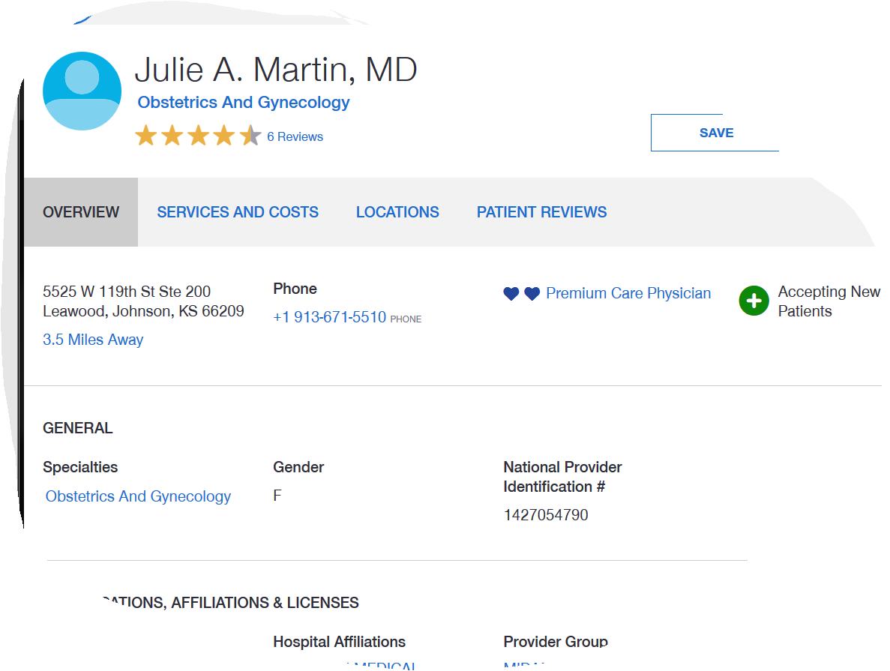
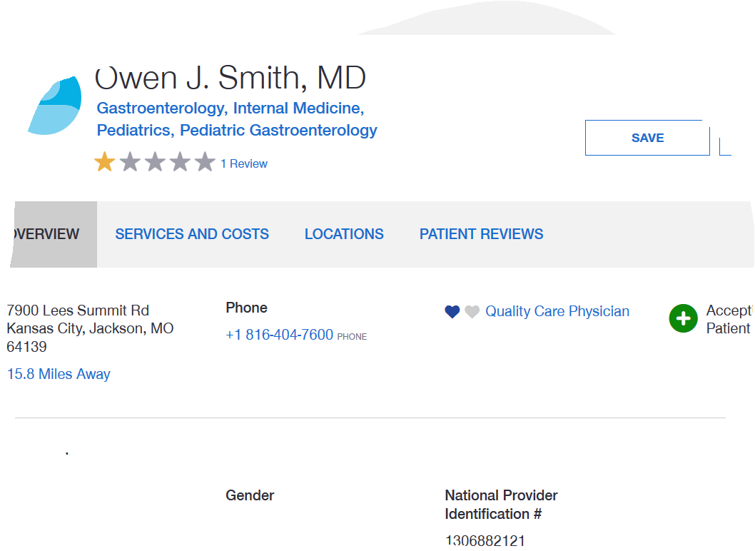
UHC Provider Lookup
Tier 1 - 2
Tier 2 – 1 or unrated

Slide 8
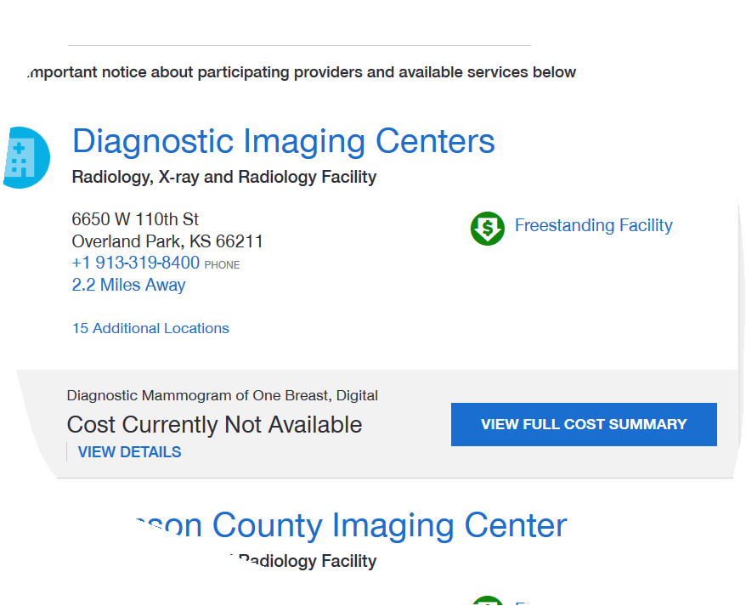
Labs
X-Rays
Outpatient Surgeries
Maximize benefits and save money by using non-hospital affiliated, freestanding facilities or outpatient surgical centers instead of hospitals.

Slide 9
Other insurance plans
New vision insurance vendor: EyeMed
  Copays and Allowances remain the same
  Lower Premium
  Large Provider Network including Mason Eye, LensCrafters, etc.
    Find a Provider www.eyemedvisioncare.com/locator
    Network: Insight
  ID Cards
No changes to premiums or plan design for other plans
  Dental, Life, Long Term Disability, and Accidental Death and Dismemberment
Notes:
EyeMed will be the new vision vendor beginning January 1, 2018. While there are no changes to the copays or allowances, the premium will be lower. The coverage through EyeMed also boasts the broad Insight network and includes providers such as Mason Eye, LensCrafter, and more.
To find a provider you can navigate to www.eyemedvisioncare.com/locator and put in your search criteria. Please note the University of Missouri System is in the “insight” network.
If you elect to enroll in the Vision Plan, Eye Med will issue Two ID cards in your name. If you don’t like carrying an ID card or you forget to take it to an appointment, you can still receive services, so don’t worry. You can simply provide your name and DOB to an in-network provider and they can look you up OR you can access your ID card through the EyeMed Members App. It’s very flexible, so you can do whichever you prefer.
Possible Questions
Will my dependents be listed on my card? –No, the name on the card will only be for the subscriber
What if my dependent forgets to take the card with them? –Your dependent will just need to provide their name and DOB to the in-network provider and they can look up their coverage.

Slide 10
Annual Enrollment Meetings
October 9th – 9am Plaza Room/Administrative Center
October 11th – 9:30am Theatre A/School of Medicine
October 12th – 1:30pm Room 4301/Health Science Bldg
October 13th – 10:30am Plaza Room/Administrative Center

